Slide 1
MINI PROJECT
Topic : Sentiment Analysis In User Reviews
AJMAL M.S.
&
PRAPANJ K.M.

Slide 2
PROBLEM STATEMENT
Data abundance in the e-commerce industry have been heading up since digitalization from 2010’s.
These data abundance are simply the user reviews in comment section in a text format.
So since the comment/review data is huge, nobody can sit and read all the comments to earn feed backs about the particu.ar product.
Sentiment Analysis (SA) is so used for, determining the positive, neutral and negative comments based upon Natural Language Processing (NPL)
If a customer/user post a comment like “This will be Apple’s best phone”, the “good” comment will be classified as positive comment and organization will improve the production in that domain.
If a customer/user post a comment like “Apple’s worst phone in software segment”, the “worst” comment will be classified as negative comment and the organization will rectify the product quality.

Slide 3
LITERATURE SURVEY

Slide 4
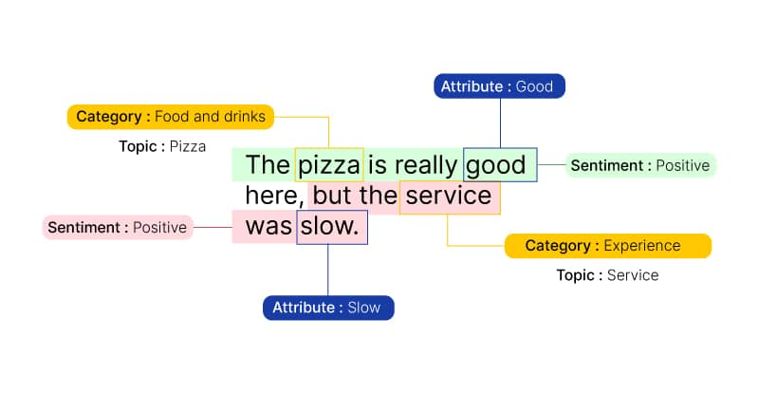
Online Media and NLP
People nowadays are ready to spent their quality amount of time in the social media and online channels like e-commerce platforms.
All the feedbacks about a change , a product, a service or an incident are shared in social media fluently.
Through NLP we can get a detailed sentiment analysis about the products, services or anything a person is occupied with.
The idea of sentimental Analysis born because of the abundancy in available data, customers have been providing in digital world every moment.

Slide 5
1. Sentiment analysis for user reviews using Bi-LSTM self-attention based CNN model
The are problems faced in Sentiment analysis like, synonyms interruption, Bias comments, and scams.
To avoid all this problems, experts suggest us to make use of self-attention based models
In today, the most effective way of analysing a sentiment using a self-attention based models are LSTM and CNN.
LSTM - Long Short Term Memory networks – usually just called “LSTMs” – are a special kind of RNN, capable of learning long-term dependencies. They were introduced by Hochreiter Schmidhuber (1997). They work tremendously well on a large variety of problems, and are now widely used.
CNN - In deep learning, a convolutional neural network (CNN/ConvNet) is a class of deep neural networks, most commonly applied to analyze visual imagery. Mostly in an array/metrices form.

Slide 6
2. Knownmis-ABSA
ASBA (Aspect Based Sentimental Analysis)
The model is grounded on the consideration that sentiment, affect, emotion and opinion are very different concepts and that it is profoundly wrong to use the same metric and the same technique to measure them
emotions: social expressions of feelings and affect influenced by culture;
sentiments: social constructs of emotions that develop over time and are enduring;
opinions: personal interpretations of information about a topic;
judgments: a personal opinion formed after thinking carefully and based on grounds that could be also incorrect; it usually contains an orientation

Slide 7
3. CRF model
Conditional Random Fields is a class of discriminative models best suited to prediction tasks where contextual information or state of the neighbors affect the current prediction.
This model is suggested to increase the efficiency of the results…

Slide 8
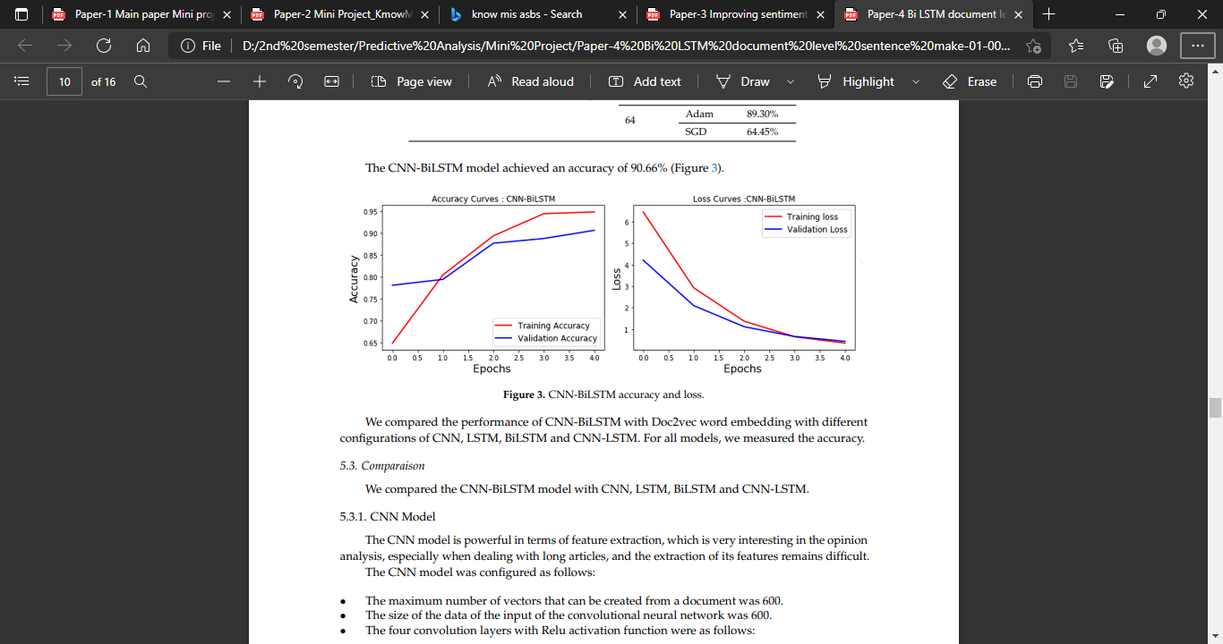
4. cNN, LSTM accuracy test

Slide 9
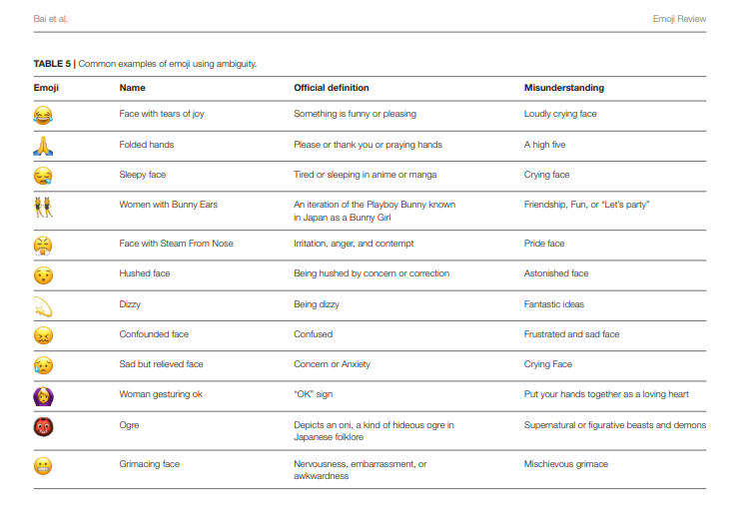
5.Emoji: Current Research and Future Perspectives

Slide 10
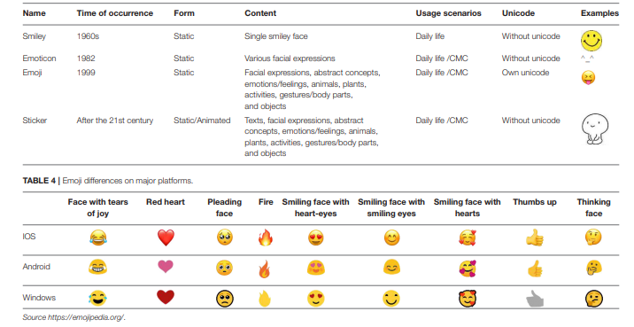
Emojis’
Emoji are used more and more frequently in network communication, and the way they are used is becoming more and more diversified as well. They not only have unique semantic and emotional features, but are also closely related to marketing, law, health care and many other areas. The research on emoji has become a hot topic in the academic field, and more and more scholars from the fields of computing, communication, marketing, behavioral science and so on are studying them.

Slide 11
6.New trends and avenues in SA
Companies use sentiment analysis to develop marketing strategies by assessing and predicting public attitudes toward their brand. Research and development focuses on designing automatic tools that crawl online reviews and condense the information gathered. Numerous companies already provide tools that track public viewpoints on a large scale by offering graphical summarizations of trends and opinions in the blogosphere. Developing opinion-tracking systems is commercially important.
Also, several tools already exist to help companies extract and analyze information from blogs about largescale trends in customers’ opinions about products; those tools include SenticNet (http://sentic.net), Luminoso (http://luminoso.com), Factiva (http:// dowjones.com/factiva), Attensity (http://attensity.com), and Converseon (http://converseon.com).

Slide 12
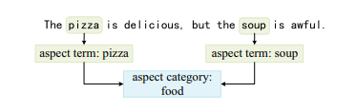
Aspect-based sentiment analysis for online reviews with hybrid attention networks
The hybrid ,model or a combination of two machine learning model have been highly recommended because of its efficiency and aspect based results.
In this model, a self attention mechanism and an aspect-attention mechanism are designed for generating the semantic representation at the word and sentence levels respectively.
Aspect-based sentiment analysis (ABSA) is an important task of sentiment analysis to identify the user sentiment on the aspects of an entity in text
ABSA involved two different subtasks according to aspect granularity, namely, aspect term sentiment analysis (ATSA) and aspect category sentiment analysis (ACSA)
ATSA would focus on the sentiment toward the aspect terms pizza and soup, while ACSA would focus on the aspect category food, even though the word food does not appear in this sentence

Slide 13
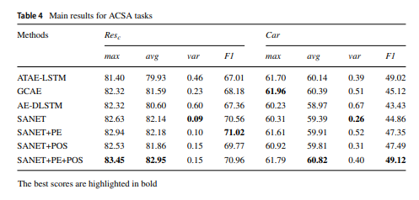
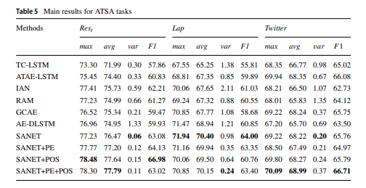
Baseline models and Accuracy

